Slide 1
SCRIPTS
01
Combining the capabilities of multithreading, IP spoofing, and ping sweeping to unlock new horizons in cybersecurity attacks!

Slide 2
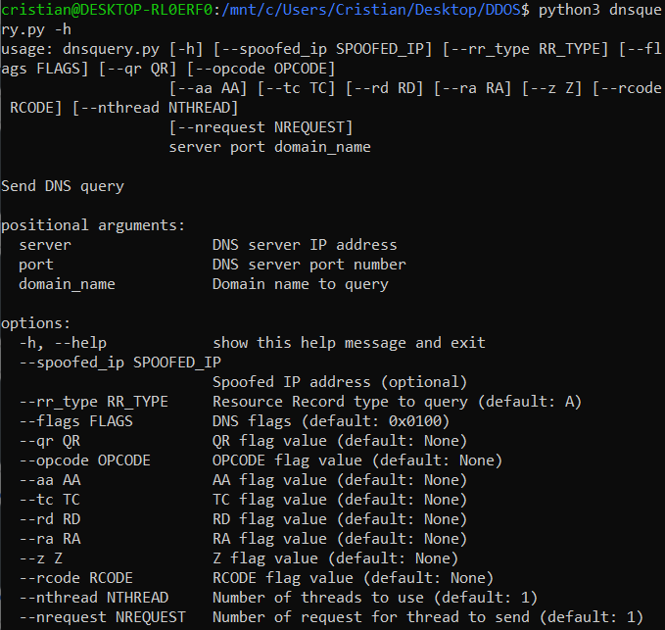
DNS query
A script was created to build and send a custom DNS query.
It allow us to:
Different DNS request type
Edit the flags
Specify spoofed IP
Use multithreading

Slide 3
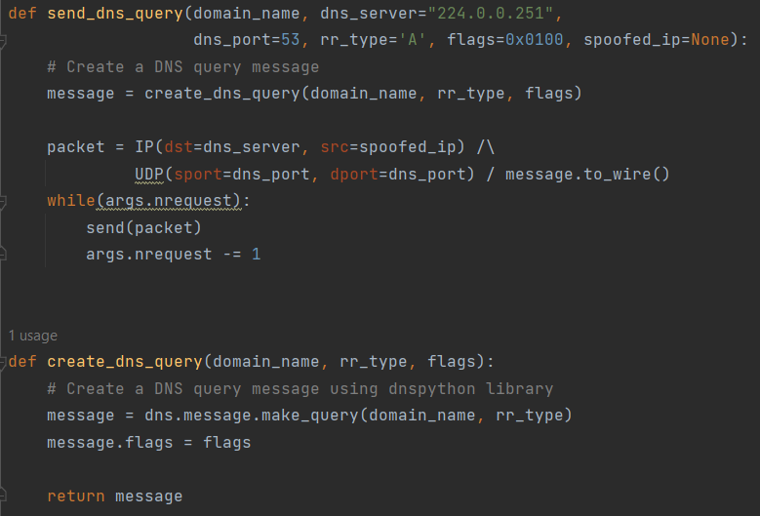
DNS script
The script was created in python using dnsphyton library to build the DNS packet and Scapy library to handle the IP header.

Slide 4
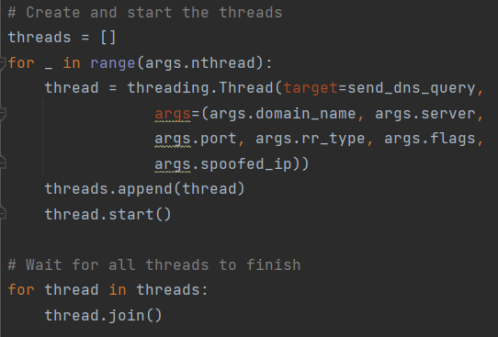
Multithreading
It was implemented using threading python library. By default is disabled, but is possible to specify the number of thread to use for the attack. It is also possible handle the total number of DNS request sent.

Slide 5
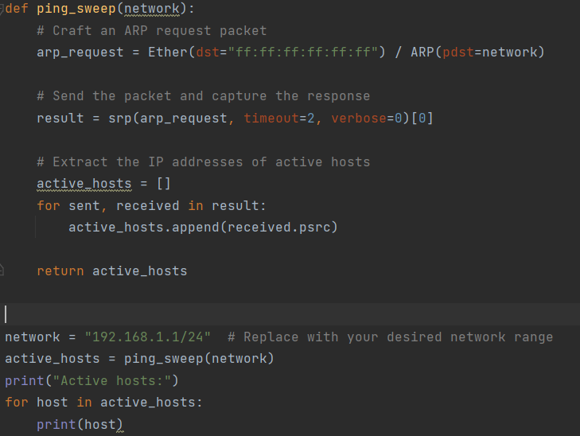
IP Spoofing
Was performed using the ping sweeping technique. Its purpose was to identify active hosts within a specific network range. By crafting Address Resolution Protocol (ARP) request packets and sending them to the network, capture the responses and extract the IP addresses of the active hosts.

